Slide 1
K Nearest Neighbor Classification
Hongyu Guo
Guo7407@saskpolytech.ca

Slide 2
Nearest Neighbor Classifiers
Basic idea:
  If it walks like a duck, quacks like a duck, then it’s probably a duck
Compute Distance
Test Record
Training Records
Choose k of the “nearest” records

Slide 3
Basic Idea
k-NN classification rule is to assign to a test sample the majority category label of its k nearest training samples
In practice, k is usually chosen to be odd, so as to avoid ties
The k = 1 rule is generally called the nearest-neighbor classification rule
Notes:
In nearest-neighbor classification, when you have a new data point that you want to classify, the algorithm identifies the single nearest neighbor from the training dataset based on a chosen distance metric (e.g., Euclidean distance), and it assigns the label of that nearest neighbor to the new data point. In other words, the class label of the new
Nearest-neighbor classification is a simple and intuitive approach, and it can be effective in various situations, especially when the decision boundaries between classes are complex or nonlinear. However, it can also be sensitive to outliers and the choice of distance metric, and it may not perform well in high-dimensional spaces due to the "curse of dimensionality." data point is determined by the class of its closest neighbor.

Slide 4
Definition of Nearest Neighbor
K-nearest neighbors of a record x are data points that have the k smallest distance to x

Slide 5
Nearest-Neighbor Classifiers: Issues
The value of k, the number of nearest neighbors to retrieve
Choice of Distance Metric to compute distance between records
Computational complexity
  Size of training set
  Dimension of data

Slide 6
Value of K
Choosing the value of k:
  If k is too small, sensitive to noise points
  If k is too large, neighborhood may include points from other classes
Rule of thumb:
K = sqrt(N)
N: number of training points
K is odd number

Slide 7
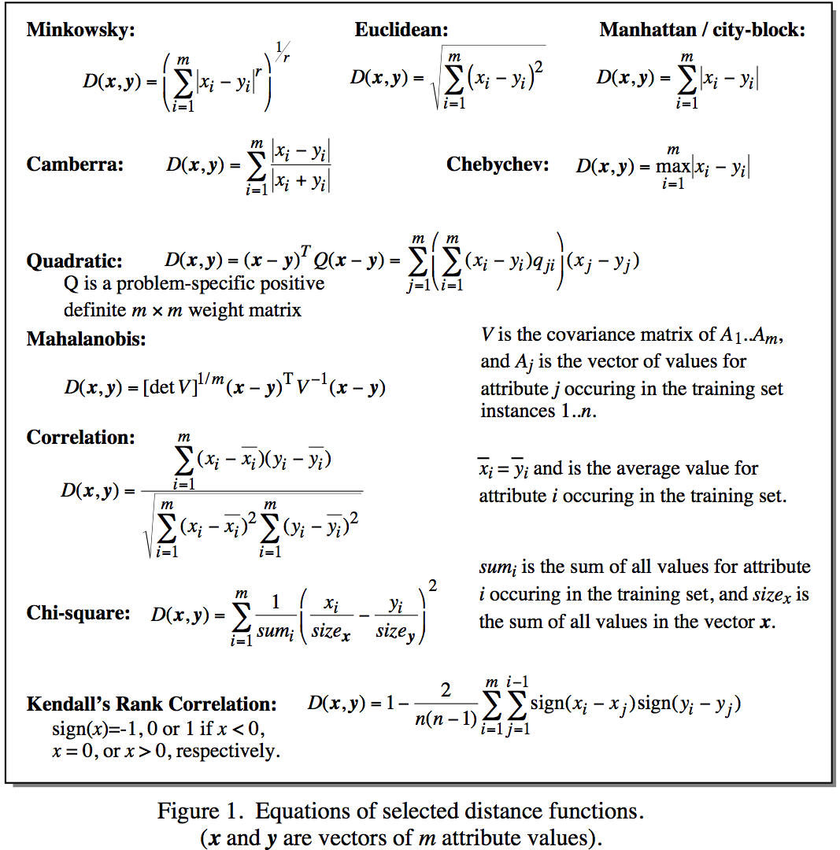
Distance Metrics
Notes:
Minkowsky = l-norm

Slide 8
Distance Measure: Scale Effects
Different features may have different measurement scales
  E.g., patient weight in kg (range [50,200]) vs. blood protein values in ng/dL (range [-3,3])
Consequences
  Patient weight will have a much greater influence on the distance between samples
  May bias the performance of the classifier

Slide 9
Standardization
Transform raw feature values into z-scores
  is the value for the i^{th} sample and j^{th} feature
  is the average of all for feature j
  is the standard deviation of all over all input samples
Range and scale of z-scores should be similar (providing distributions of raw feature values are alike)

Slide 10
Nearest Neighbor : Dimensionality
Problem with Euclidean measure:
  High dimensional data
    curse of dimensionality
    As the number of dimensions increases, the distance between data points becomes less meaningful.
  Can produce counter-intuitive results
  Shrinking density – sparsification effect
    In high-dimensional spaces, data points tend to become more dispersed, and the density of data points decreases.
    This means that the nearest neighbors of a data point may not provide a representative or meaningful view of the data because they are too far away.
    As a result, distance-based algorithms that rely on the Euclidean measure can be adversely affected, as they may not accurately capture the underlying structure of the data.
Notes:
Increased Sparsity: In high-dimensional spaces, the volume of the space grows exponentially with the number of dimensions. As a result, data points become increasingly sparse. Most of the volume is in the "corners" of the space, and there is relatively little data in the central regions. This sparsity means that data points are far apart from each other, making them seem less similar.
Data Concentration: In high-dimensional spaces, data points tend to concentrate near the boundary of the space, often referred to as the "curse of the boundary." This means that most of the data points are found in a thin shell around the high-dimensional space, rather than distributed uniformly throughout the space. As a result, two random data points are likely to be far apart.
Diminishing Discriminative Power: As the number of dimensions increases, the relative differences in distances between data points become very small. In other words, the distance between the nearest and farthest data points starts to converge. This phenomenon means that traditional distance-based measures like Euclidean distance may no longer effectively discriminate between data points.
Loss of Geometric Intuition: In high-dimensional spaces, our geometric intuition, which works well in two or three dimensions, becomes less applicable. Features that are far apart in one dimension may actually be close together in high-dimensional space, and vice versa. This makes it challenging to interpret or reason about the relationships between data points.
Increased Computational Complexity: High-dimensional data can lead to computational challenges and increased computational costs. For example, nearest-neighbor search or clustering algorithms can become significantly slower and require more memory as the dimensionality of the data increases.
To address these issues in high-dimensional data, dimensionality reduction techniques (e.g., Principal Component Analysis or t-Distributed Stochastic Neighbor Embedding) are often used to reduce the number of dimensions while preserving essential information. Additionally, alternative distance metrics, such as cosine similarity or Mahalanobis distance, may be employed to better capture the similarity between data points in high-dimensional spaces.

Slide 11
Nearest Neighbour : Computational Complexity
Expensive
  To determine the nearest neighbour of a query point q, must compute the distance to all N training examples
Storage Requirements
  Must store all training data P
    Remove redundant data (condensing)
High Dimensional Data
  “Curse of Dimensionality”
    Required amount of training data increases exponentially with dimension
    Computational cost also increases dramatically

Slide 12
Elbow Method in Supervised Machine Learning(Optimal K Value)
  https://medium.com/@moussadoumbia_90919/elbow-method-in-supervised-learning-optimal-k-value-99d425f229e7
https://www.youtube.com/watch?v=4HKqjENq9OU&t=18s
https://www.kaggle.com/code/shrutimechlearn/step-by-step-diabetes-classification-knn-detailed/notebook

